Slide 1


N.B.K.R.I.S.T ENGINEERING COLLEGE VIDYANAGAR
AUTONOMOUS
A Review on..
CUSTOM FILE SYSTEM
Under the guidance of
Presented by
N.SYLESH (24KB1A3071)
G.SAMPATH (24KB1A3027)
Y.SRINIVASULU (24KB1A30D2)
V.SIVA (24KB1A30C4)
G.TEJA (24KB1A3028)
P.PRASANTH
SURESH GUPTA

Slide 2
INTRODUCTION
TITLE:
Custom File System
CONTENT:
Educational tool for learning data structures
Command line practice
Foundation of Operating System concepts
Team-Based software development
Base for advance file system features

Slide 3
OBJECTIVE
GOALS:
Simulate a simple file system in C
Implement core data structures practically
Design and Command based interface
Encouraging modular and team based development
Build reusable and scalable code
Improve command parsing and error handling
Enhance coding confidence and presentation skills

Slide 4
WHY C AND DSA?
High Performance and Speed
Strong understanding of core concepts
Better control over memory management
Closer to system level programming

Slide 5
IMPLIMENTATION DETAILS
Components :
MODULE 1 :
This is the entry point of the project
Handle user input and pass it to next module
MODULE 2 :
This defines the folder and file blueprints
Declare global variables (root,current) and function prototypes
MODULE 3 :
This module create and link directories properly
Navigate inside the folder structure
Display the current file system hierarchy
MODULE 4 :
This module manages creation and linking of files
Keep files organized inside their respective directories
MODULE 5 :
Parses the user input command
Act as a bridge between users action and system logic

Slide 6
MODULE 1
(MAIN.C)
This is the entry point of the project.
It initializes the root directory and sets the current working directory.
It runs an infinite loop to take user commands and forward them to the command handler.
It controls the overall flow of the file system simulation.
Key Responsibilities:
Set up starting environment.
Display prompt ([folder]$) to the user
Handle user input and pass it to the next module

Slide 7
MODULE 2
(Filesystem.h)
It defines the data structures used throughout the project:
Directory Folder
File structure (files)
It declares all functions needed for directories, files, and command handling.
It ensures that all .c files are linked properly and share common information.
Key Responsibilities:
Define folder and file blueprints.
Declare global variables (root, current) and function prototypes

Slide 8
MODULE 3
(dir_tree.c)
This module handles everything related to folders:
Create a folder (mkdir)
Change folder (cd)
List contents (ls)
Show path (pwd)
It uses tree structure logic to simulate a real directory tree.
Key Responsibilities:
Create and link directories properly.
Navigate inside the folder structure.
Display the current file system hierarchy

Slide 9
MODULE 4
(file_manager.c)
This module handles everything related to files:
Create a file (touch)
It simulates how files are added inside folders.
It uses linked lists to manage multiple files inside a single folder.
Key Responsibilities:
Manage creation and linking of files.
Keep files organized inside their respective directories.

Slide 10
MODULE 5
(command_handler.c)
Parses the user’s input command.
Decides which function should be called based on the command (mkdir, touch, cd, ls, pwd,etc).
Acts as a bridge between the user's actions and the system logic.

Slide 11
COMMANDS
mkdir :- Make Directory
Used to create the new directory inside the current directory.
touch :- Create file
Creates a new file in the current directory.
cd :- Change Directory
Changes the current directory to the specified one.
cd .. :- Up Directory
Go back to the previous directory.
ls :-List Directory
Lists all files and folders in the current directory.
pwd :- Print working directory
Shows the full path of the current directory.

Slide 12
COMMANDS
rm :- Remove file
Delete the specified file from the current directory.
rmdir :- Remove directory
deletes an empty directory from the current folder.
edit :- Edit txt files
Opens the file for editing and lets you enter content.
view :- View file content
Display the content of the specified file.
Import :- Import file
Loads a .txt file from the disk.
export :- Export file
Saves a virtual file to real file on disk.

Slide 13
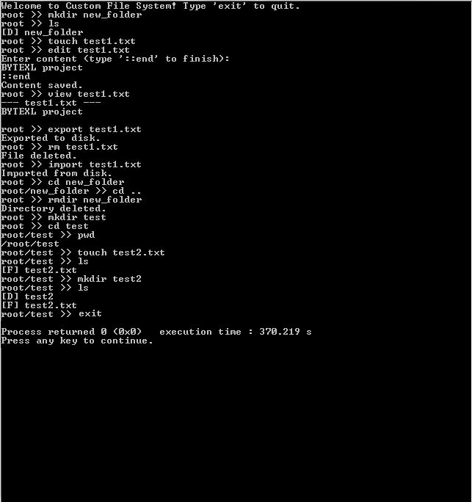
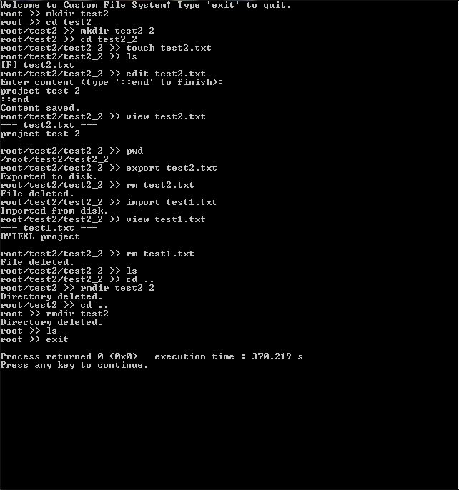
Output Screen 1
Output Screen 2

Slide 14
FUTURE IMPROVEMENTS
FILE HISTORY
Keep a history of changes made to a file.
FILE PERMISSIONS
Support read/write/execute permissions for files and folders (like Linux).
SEARCH FUNCTION
Add a search <name> command to find a file or folder any where in the system.
GUI FRONTEND
Build a simple GUI (e.g., in Python, Java, or C++) for managing files visually.

Slide 15
Source Code :
https://github.com/NELLORESYLESH/CFS_PROJECT.git

Slide 16
THANK YOU

